Slide 1


Retrieval Augmented Generation (RAG)

Slide 2
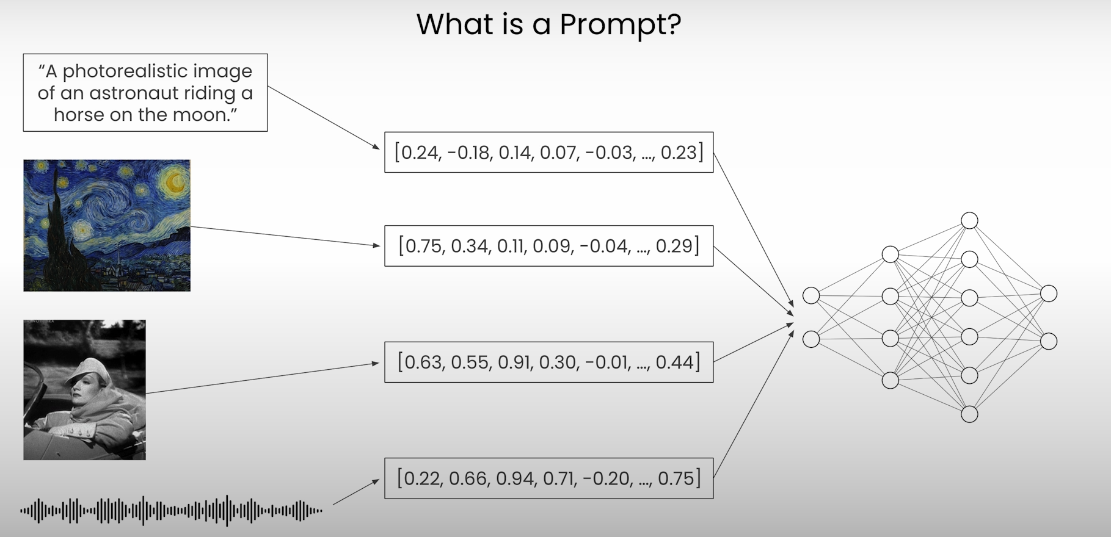
Embedding - recap

Slide 3
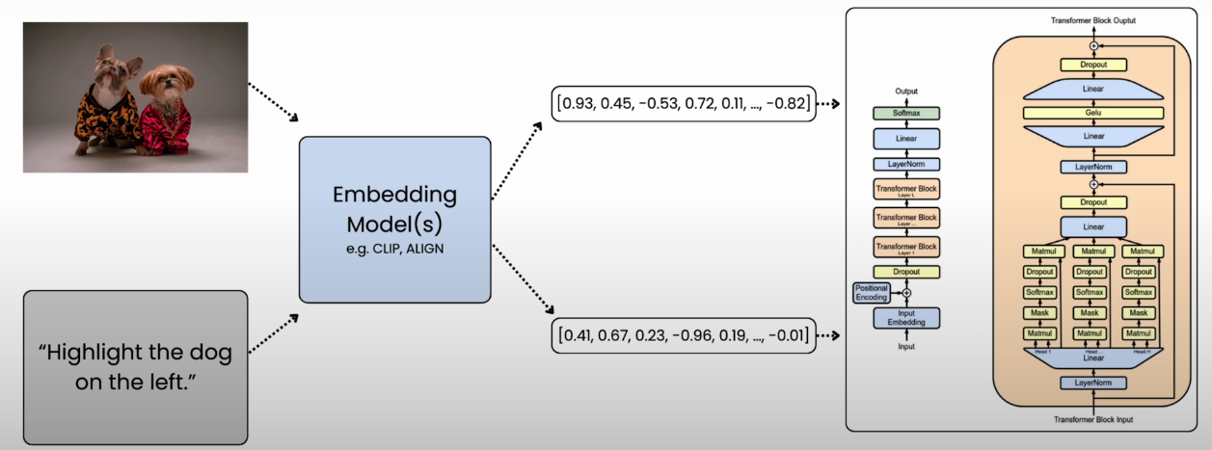
Embeddings - recap

Slide 4

Retrieval Augmented Generation (RAG) example
Retrieval augmented generation (RAG)
• Give LLM access to external data sources

Slide 5
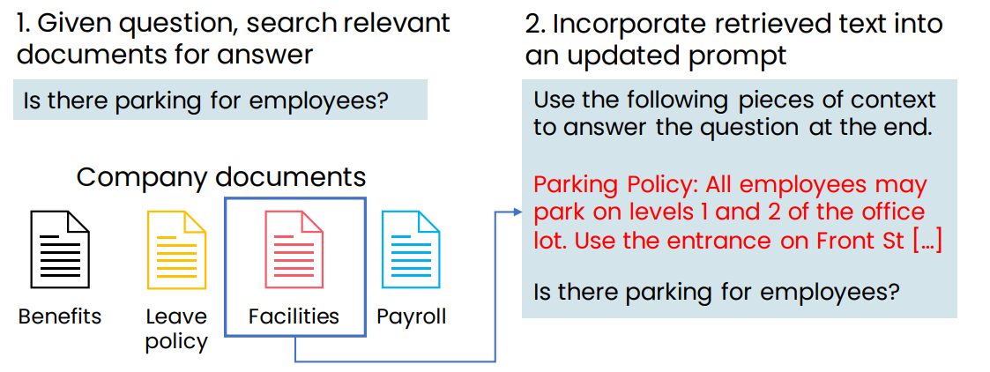
Retrieval Augmented Generation (RAG) example

Slide 6
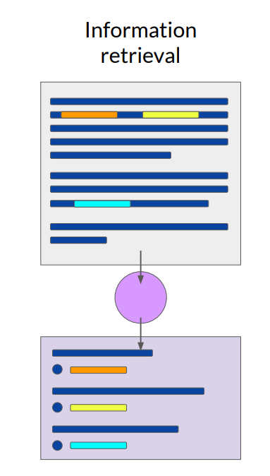
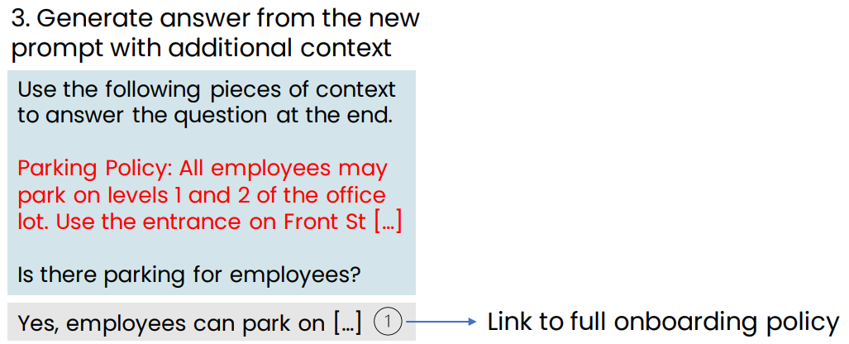
Retrieval Augmented Generation (RAG) example

Slide 7
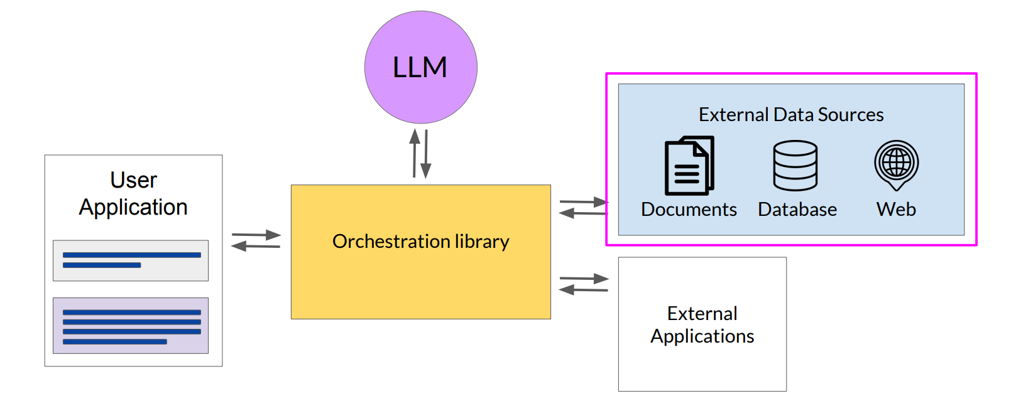
RAG Architecture

Slide 8
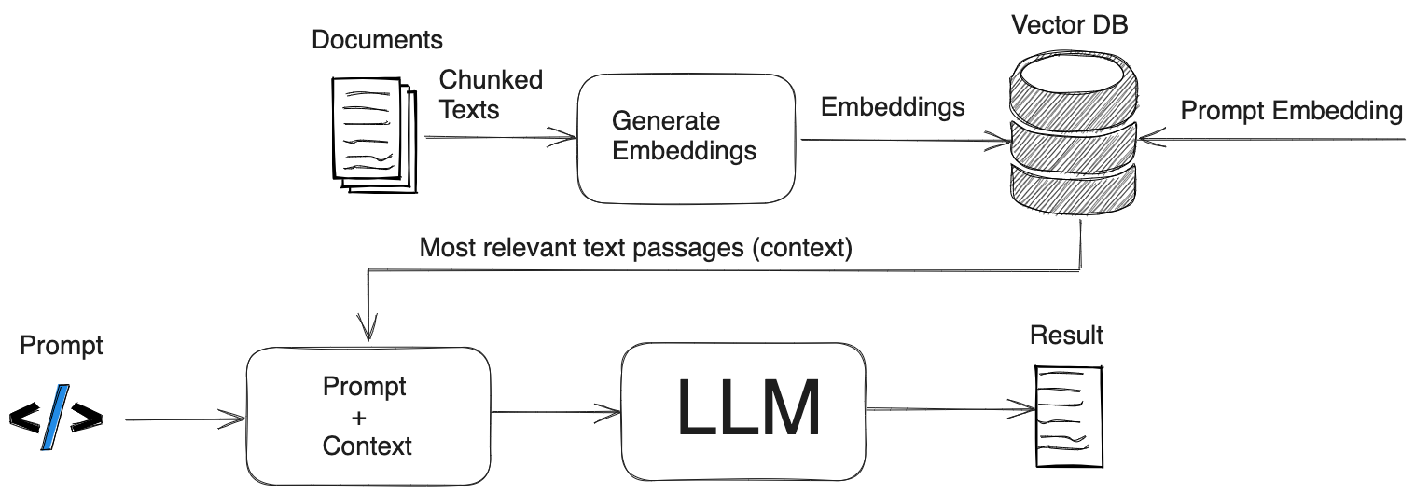
RAG Architecture

Slide 9
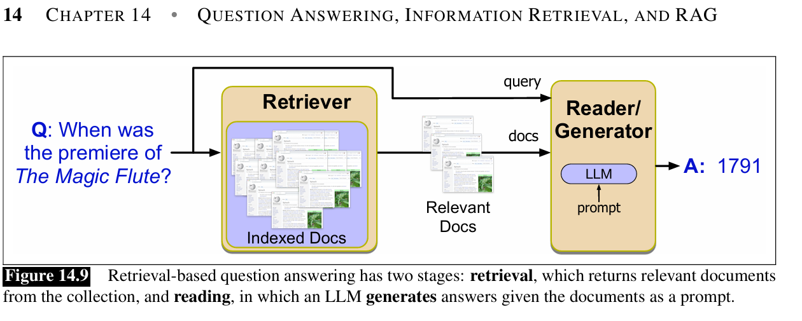
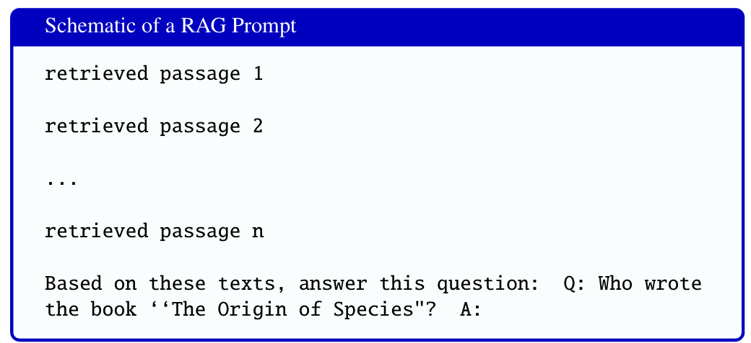

Slide 10
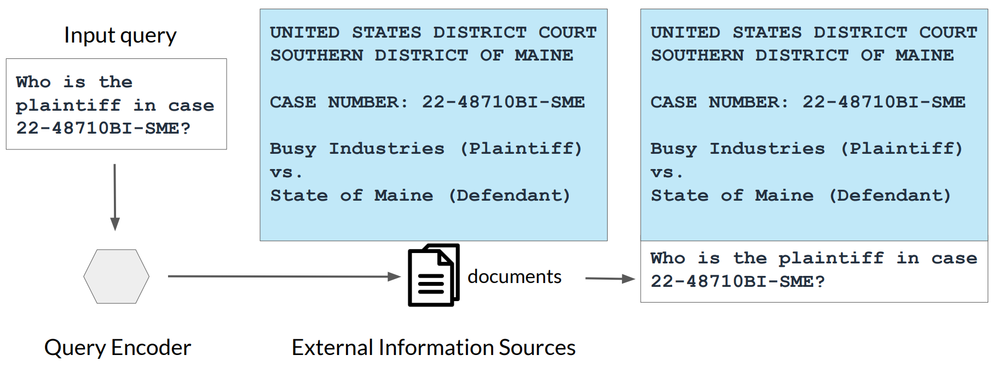
Example: Searching legal documents

Slide 11
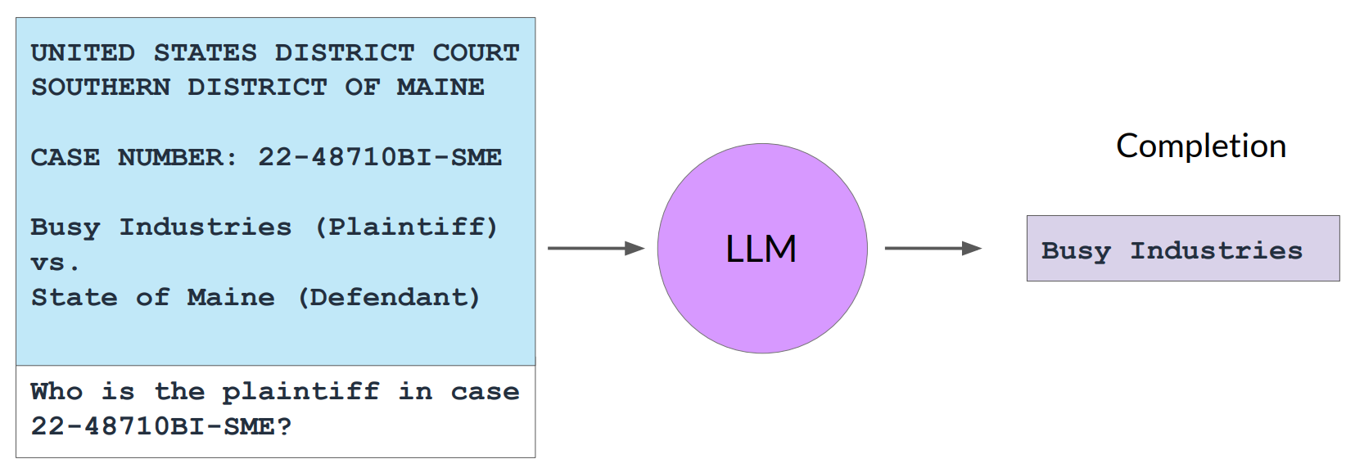
Example: Searching legal documents

Slide 12
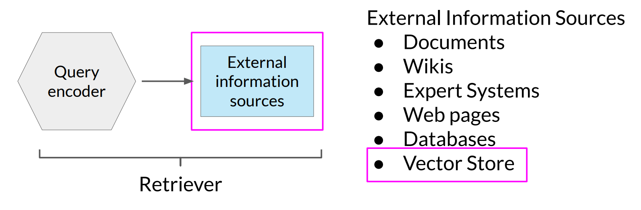
RAG integrates with many types of data sources

Slide 13
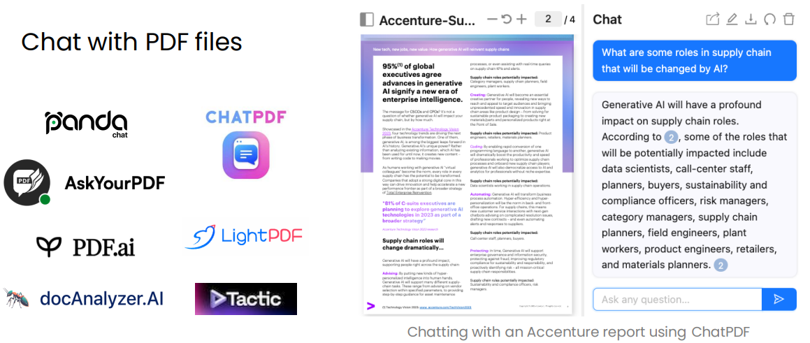
Examples of RAG applications

Slide 14
RAG applications
https://pandachat.ai
https://www.chatpdf.com
https://askyourpdf.com
https://pdf.ai
https://docAnalyzer.ai
https://lightpdf.com
https://notebooklm.google.com/

Slide 15

Examples of RAG applications
Answer questions based on a website’s articles
Coursera Coach

Slide 16

Examples of RAG applications: Langchain Docs

Slide 17
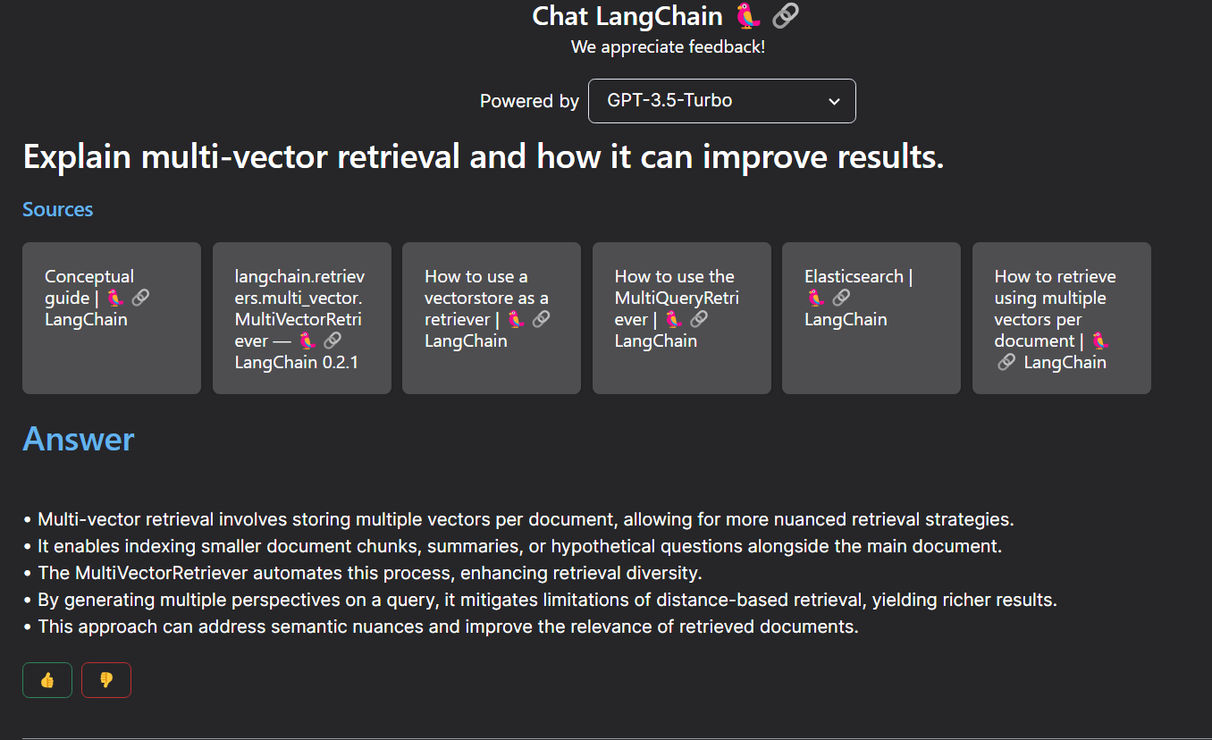
Examples of RAG applications: Langchain Docs

Slide 18
Tools

Slide 19
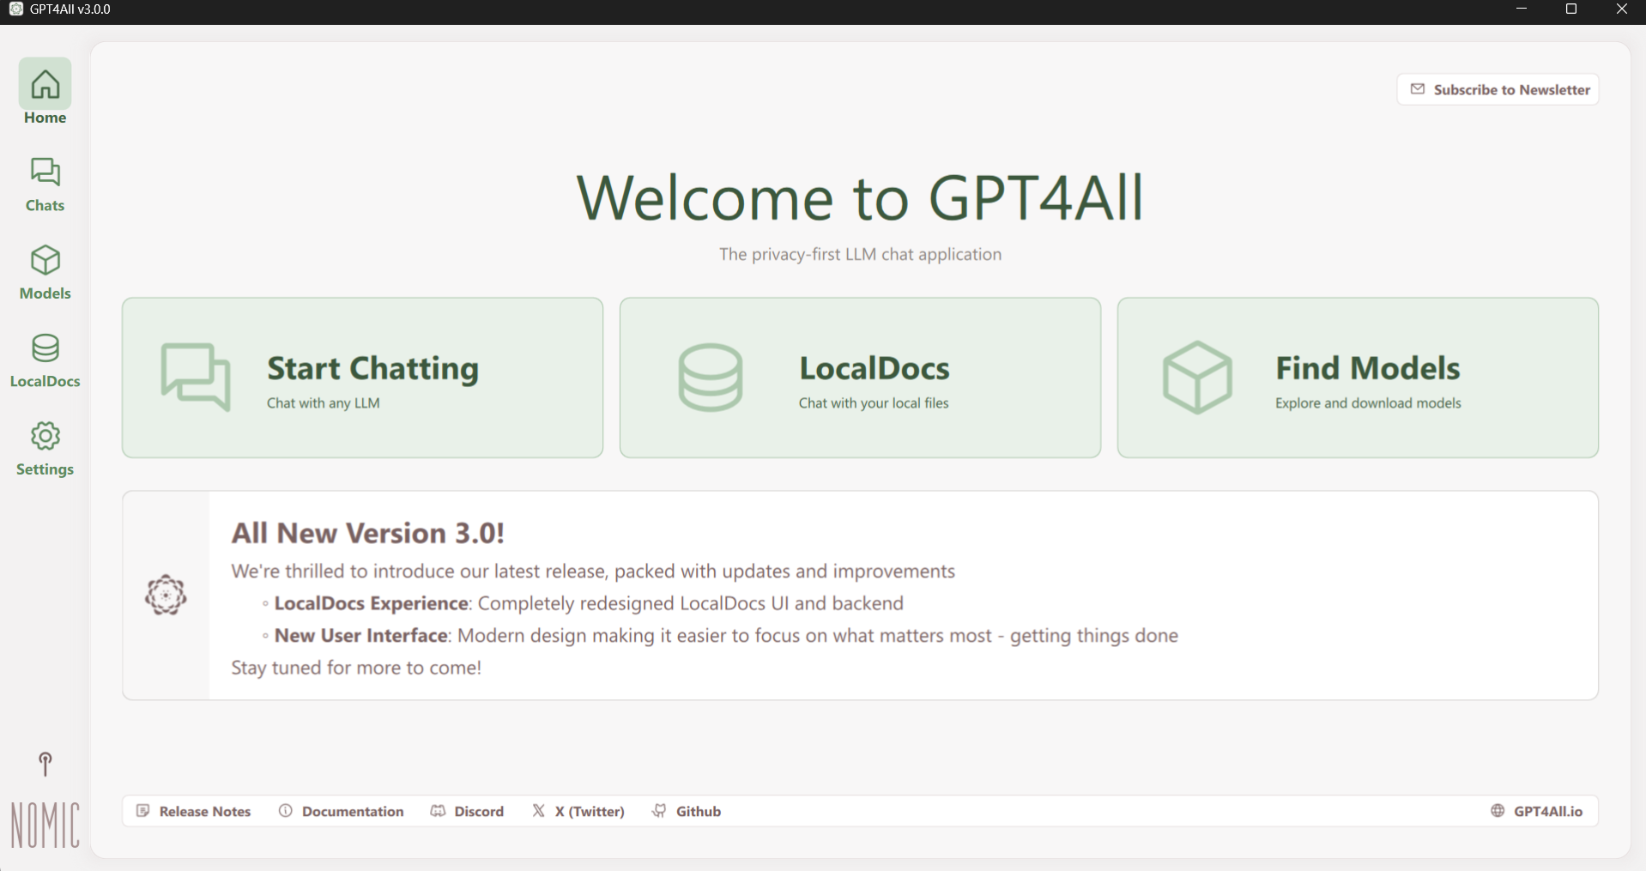
GPT4all RAG

Slide 20
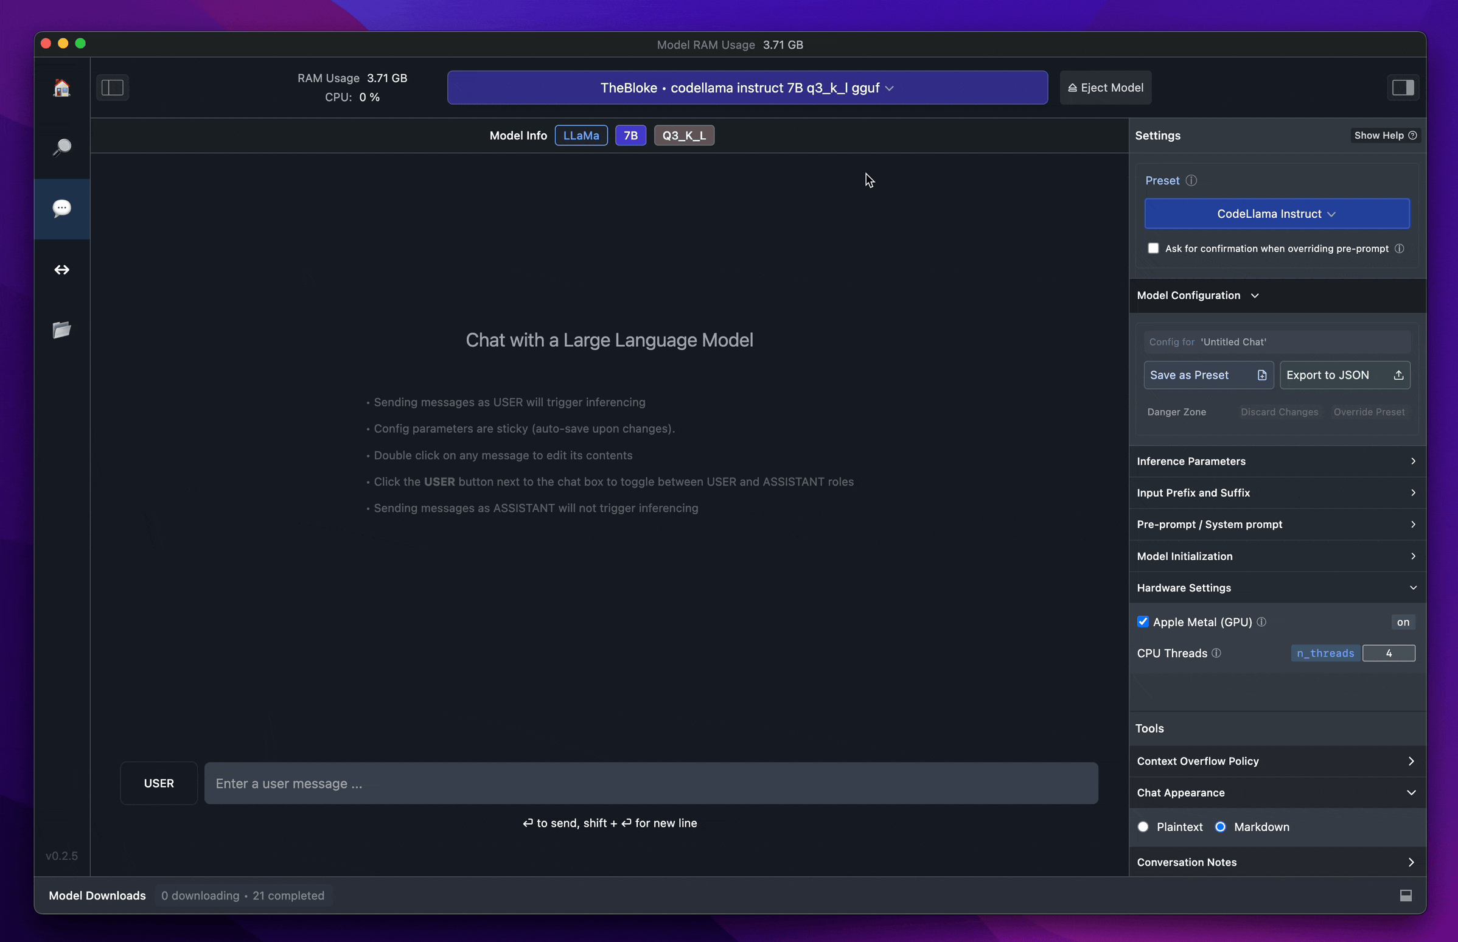
LM Studio

Slide 21

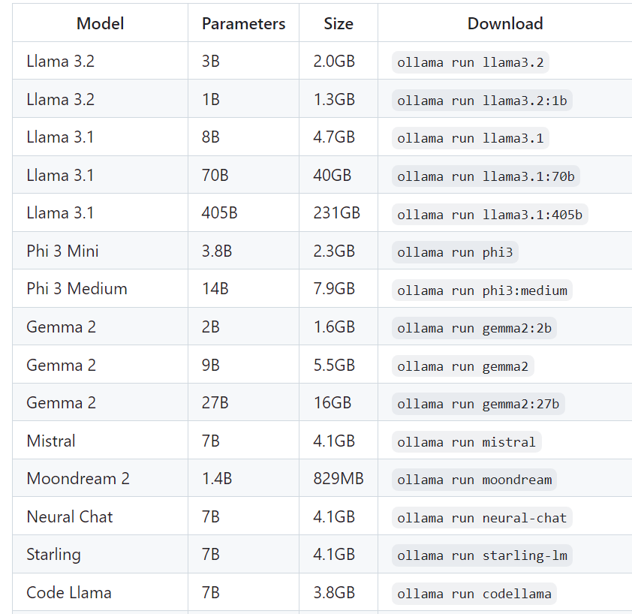

Ollama

Slide 22


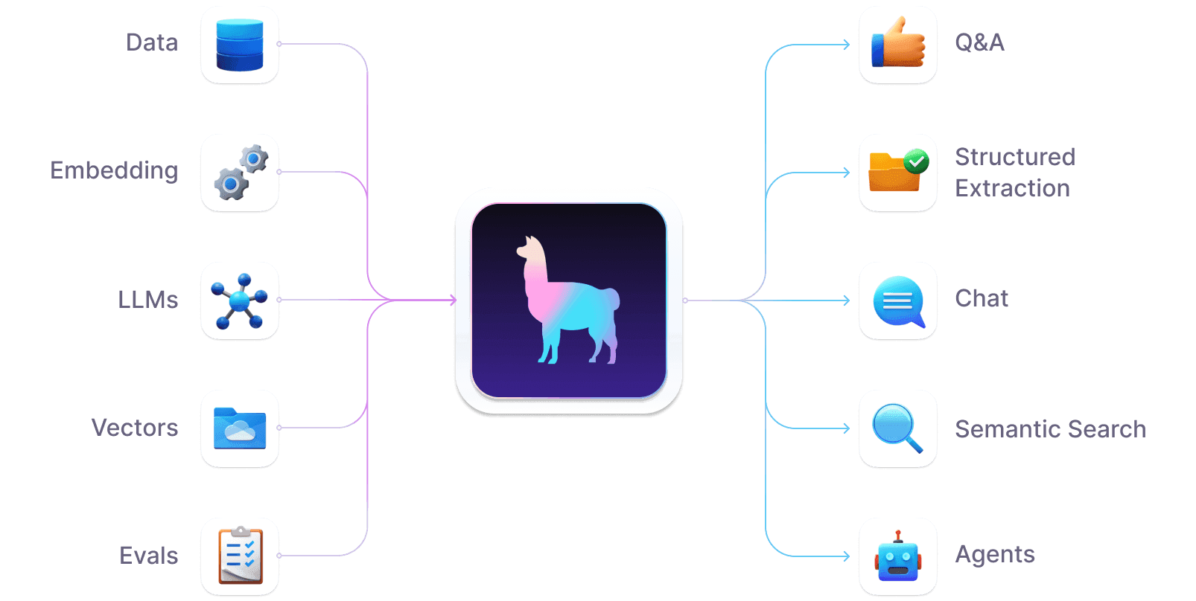
Llama Index

Slide 23
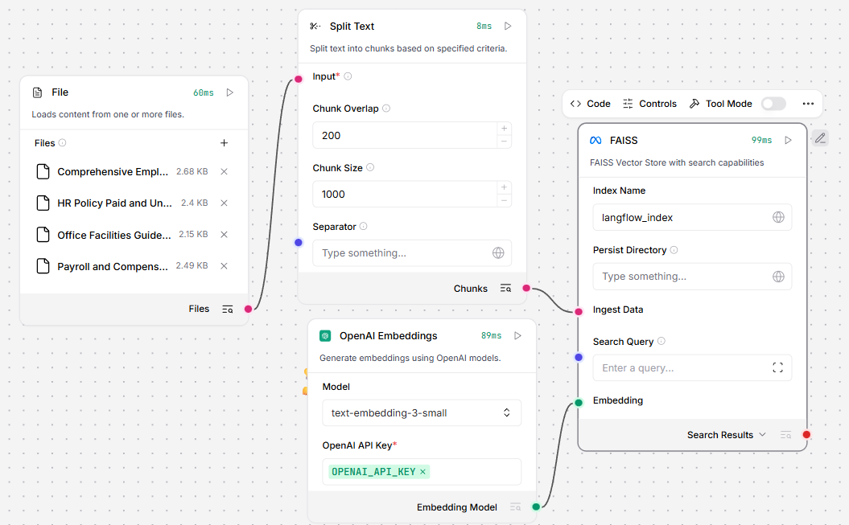
KB embedding

Slide 24
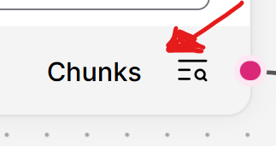
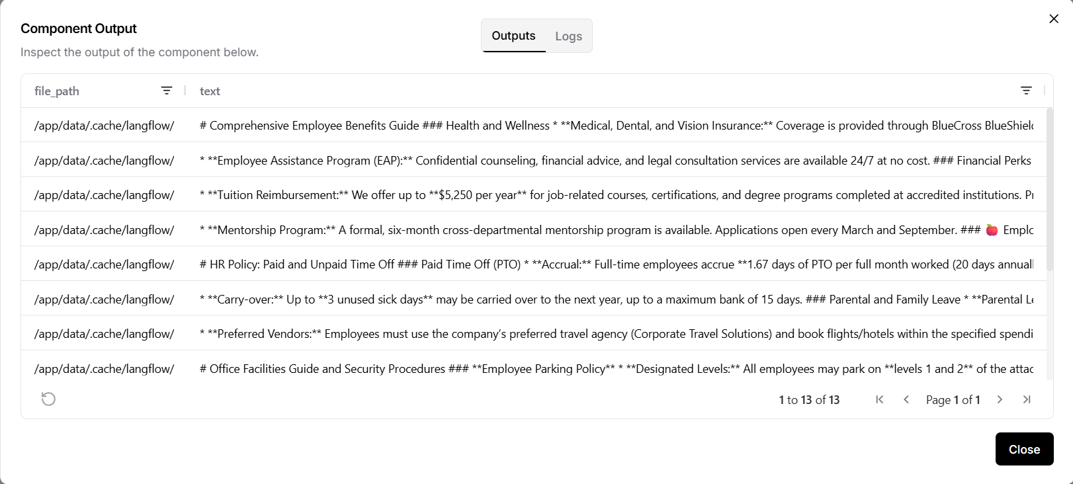
Chunks

Slide 25
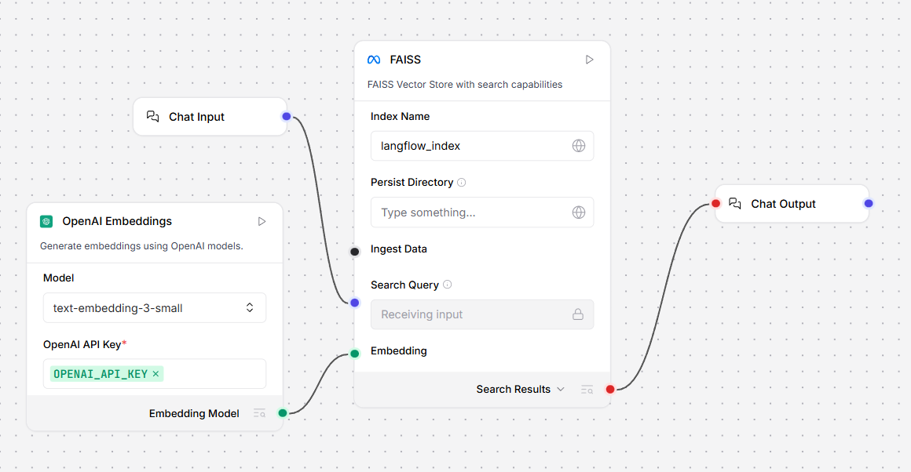
IR flow

Slide 26
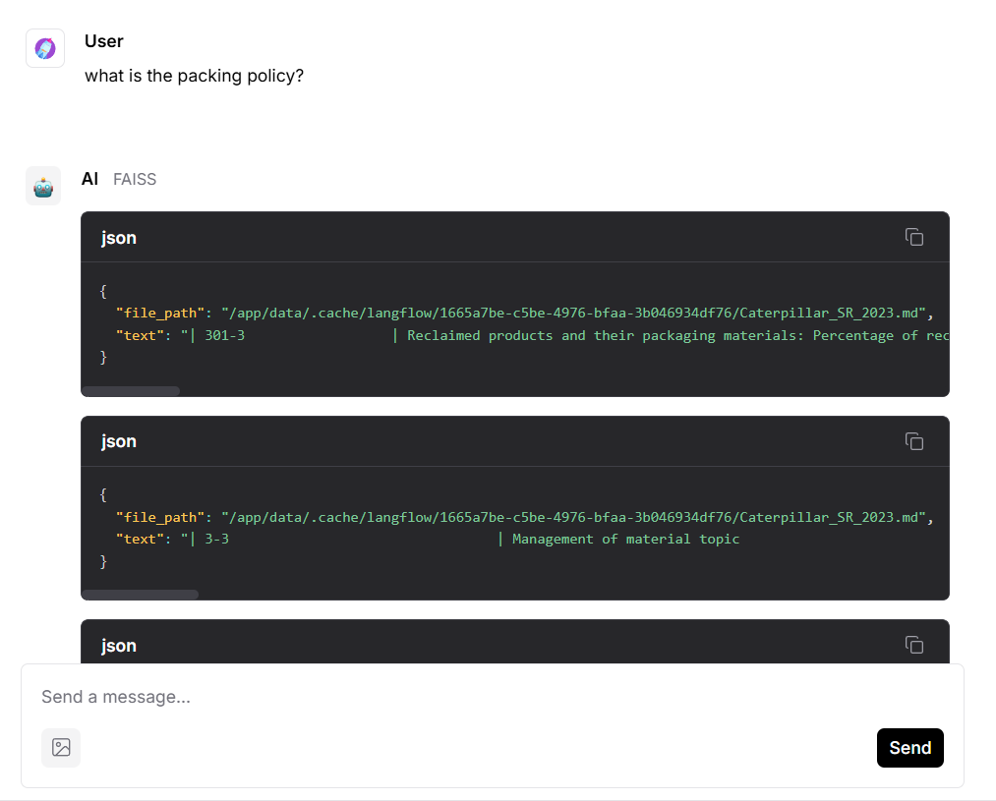
IR in chat

Slide 27
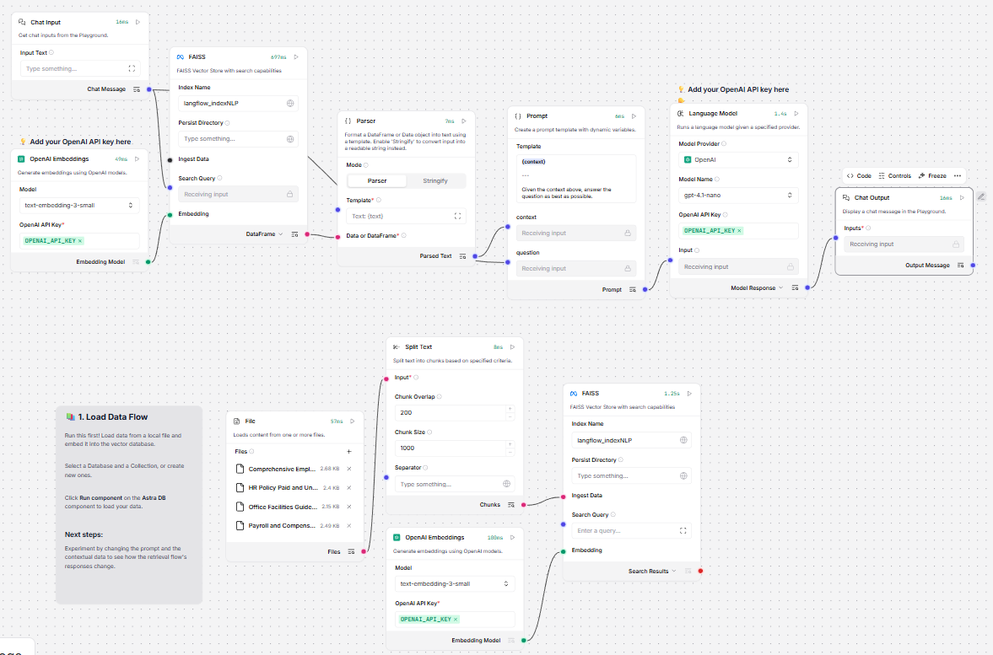
RAG flow

Slide 28

RAG chat

Slide 29

RAG chat

Slide 30
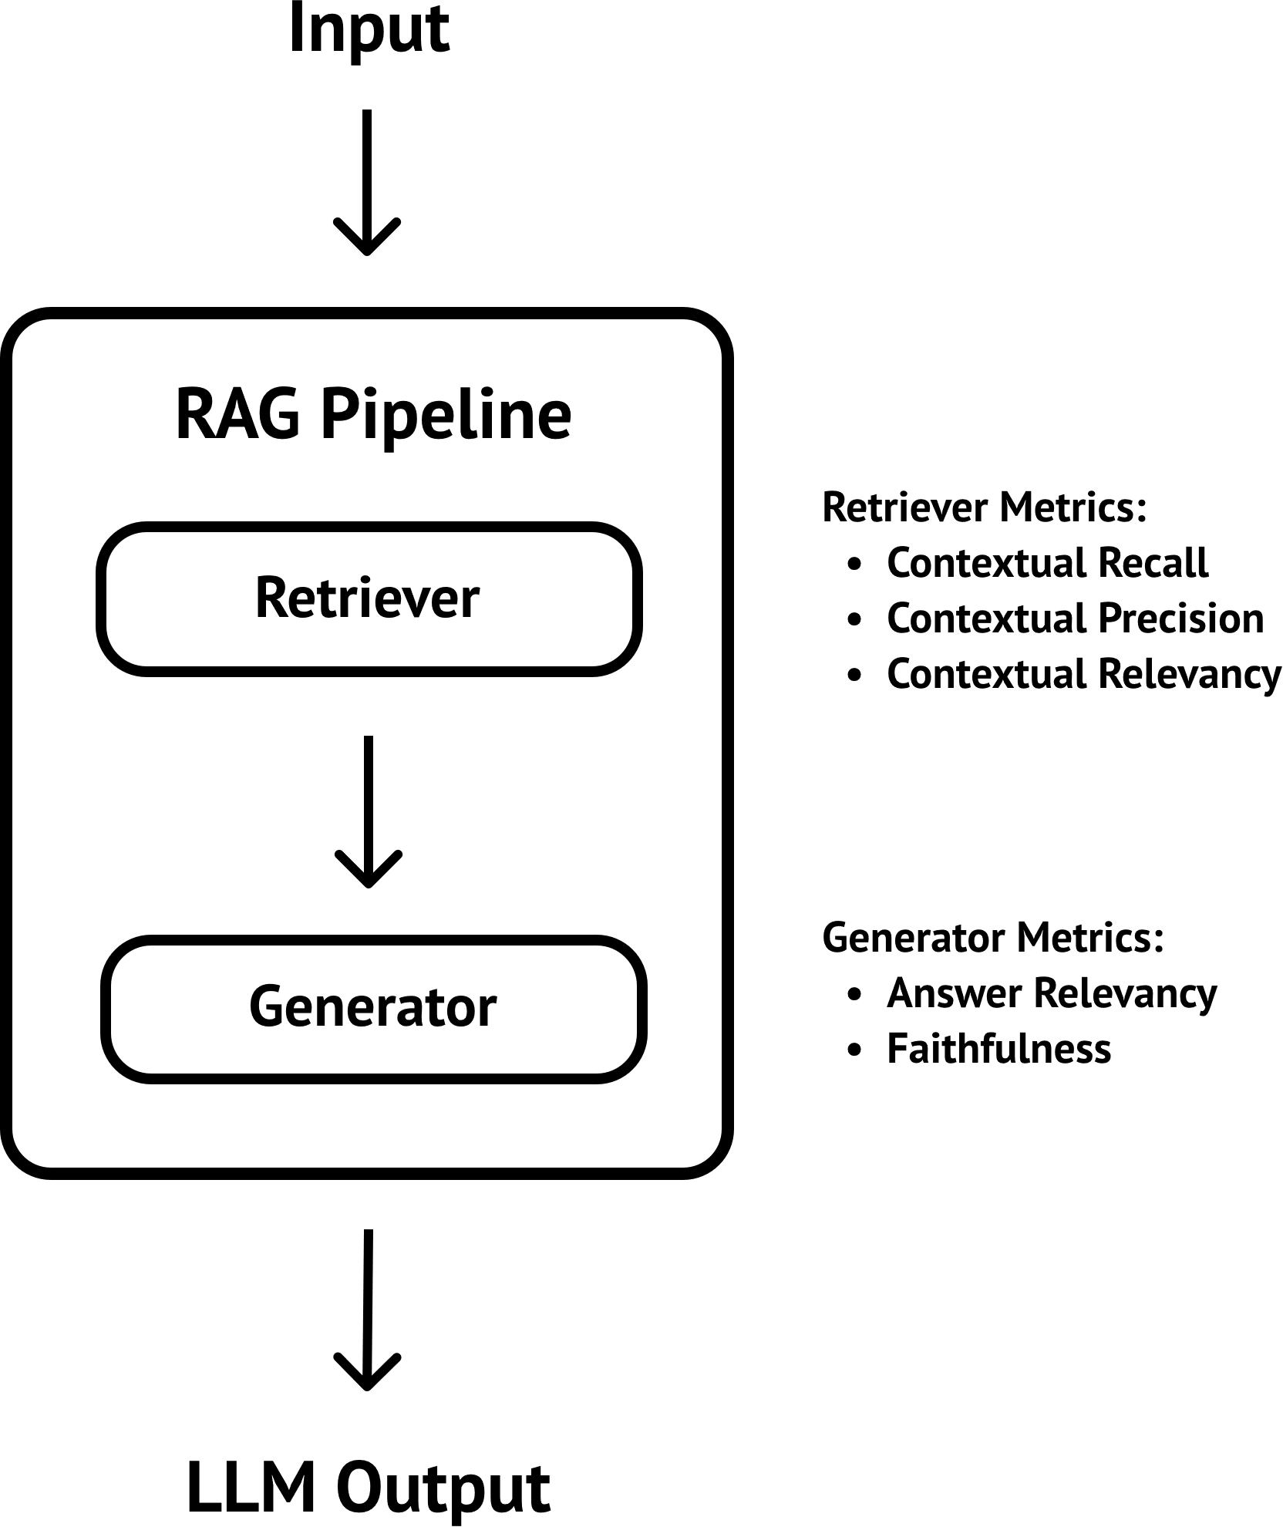
RAG Evaluation

Slide 31
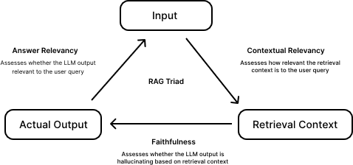
RAG Triad

Slide 32
RAG triad
The RAG triad is composed of three RAG evaluation metrics: answer relevancy, faithfulness, and contextual relevancy.
If a RAG pipeline scores high on all three metrics, we can confidently say that our RAG pipeline is using the optimal hyperparameters.

Slide 33
Answer relevancy
Answer relevancy: the answer relevancy metric determines how relevant the answers generated by your RAG generator is.
hyperparameter: prompt template
A low answer relevancy score signifies that you need to improve examples used in prompt templates for better in-context learning or include more fine-grained prompting for better instruction following capabilities to generate more relevant responses.

Slide 34
Faithfulness
The faithfulness metric determines how much the answers generated by your RAG generator are hallucinations.
This concerns the LLM hyperparameter,
Switch to a different LLM OR fine-tune your own

Slide 35
Contextual Relevancy
The contextual relevancy metric determines whether the text chunks retrieved by your RAG retriever are relevant to producing the ideal answer for a user input.
This concerns the chunk size, top-K and embedding model hyperparameter.
A good embedding model ensures you're able to retrieve text chunks that are semantically similar to the embedded user query, while a good combination of chunk size and top-K ensures you only select the most important bits of information in your knowledge base.

Slide 36
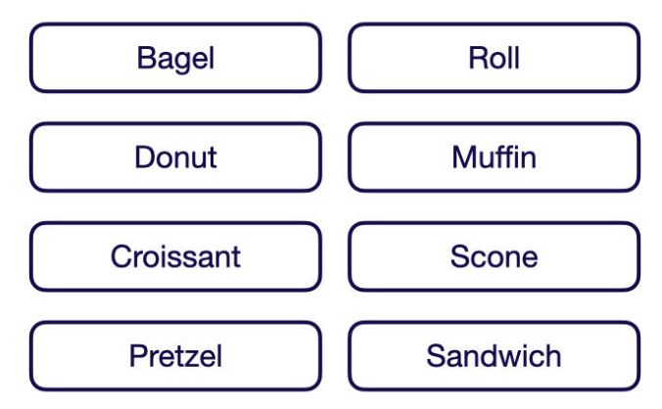
Evaluation Metrics for Search and RAG
To explain how each of the following metrics is calculated, this article uses a minimal example dataset of eight pastries

Slide 37
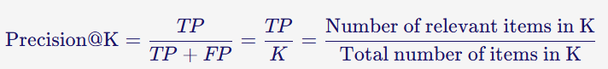
Metrics to Evaluate Information Retrieval Systems
Precision
The precision@K metric measures how many of the retrieved items are relevant.
This metric is not rank-aware and thus only considers the number of relevant results but not their order.
You can calculate precision@K by dividing the number of relevant items within the top K results by K.

Slide 38
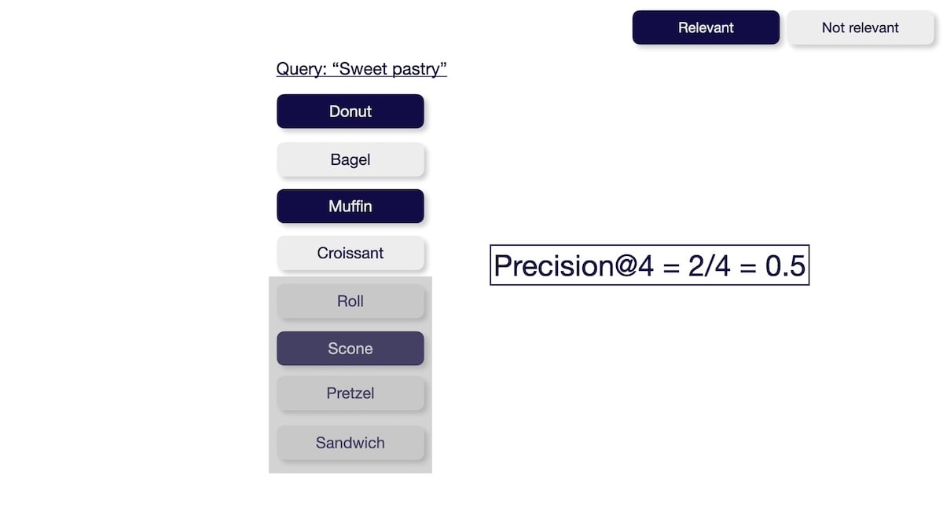

Slide 39
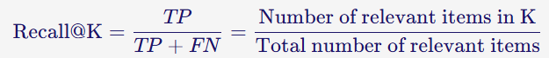
Recall
The recall@K metric measures how many relevant items were successfully retrieved from the entire dataset. This metric is not rank-aware and thus only considers the number of relevant results but not their order. You can calculate the recall@K by dividing the number of relevant items within the top K results by the total number of relevant items in the entire dataset.

Slide 40
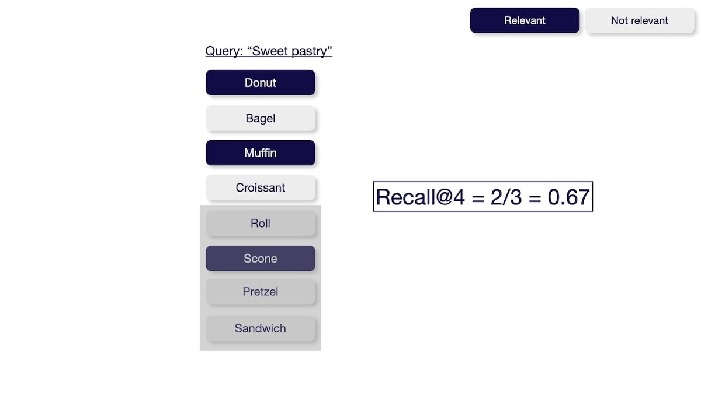

Slide 41
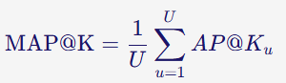
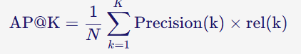
Mean Average Precision (MAP)
The Mean Average Precision@K (MAP@K) metric measures the system's ability to return relevant items in the top K results while placing more relevant items at the top.

Slide 42
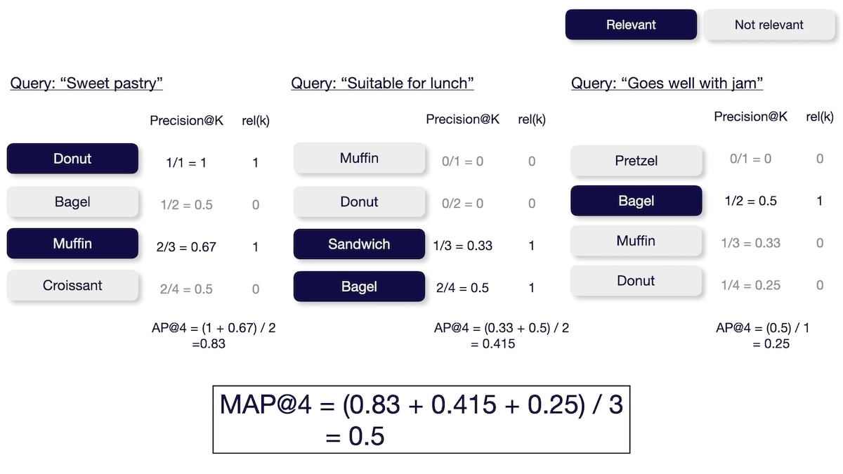

Slide 43
Normalized Discounted Cumulative Gain (NDCG)
The Normalized Discounted Cumulative Gain@K (NDCG@K) metric measures the system's ability to sort items based on relevance.
Requires not only if a document is relevant but also how relevant it is (e.g., relevant vs. somewhat relevant vs. not relevant).
You can calculate the NDCG@K by calculating the discounted cumulative gain (DCG) and then normalizing it over the ideal discounted cumulative gain (IDCG).

Slide 44
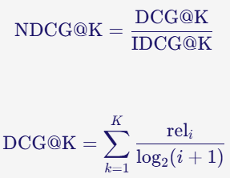
NDCG

Slide 45
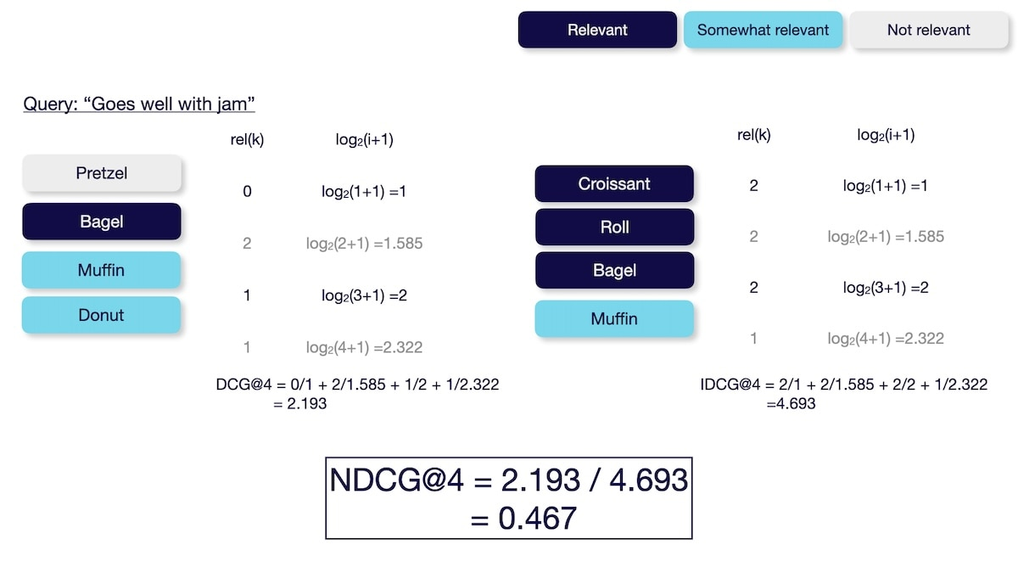

Slide 46


Q&A

